Slide 1
Lakehouse in a Day

Slide 2
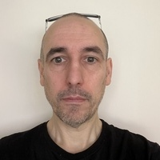
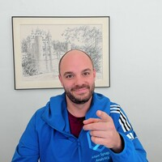
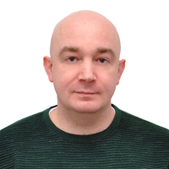
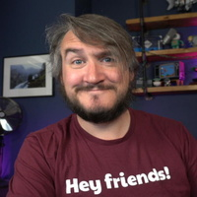
Mark Pryce-Maher | Microsoft
@MarkPM_MSFT
Stijn Wynants | Microsoft
@SQLStijn
Filip Popovic | Microsoft
Simon Whiteley | Advancing Analytics
@MrSiWhiteley

Slide 3

The Plan
Bronze
Silver
Gold
Lakehouse Primer
For each phase we will:
Discuss Zone Requirements
Let you loose to get stuck in and build something
Provide continuous guidance & help with our coaches
Regroup to review template solutions
Review questions from the groups
Landing to Bronze
Bronze to Silver
Silver to Gold
Serving & Orchestration
Discussions

Slide 4
How is today going to work?
Groups of 3 - 5

Slide 5
Housekeeping
Morning Break: 10:45
Lunch: 13:00
Afternoon Break: 15:00
Any other logistics?

Slide 6

Questions
Questions at any time
Wave at coaches if you need help
This session is for you, so ask any questions you want!

Slide 7

Takeaways
Hands-on Practice building a Lakehouse
ANY questions answered by the coaches
Full example solutions in each technology

Slide 8
Each team can either nominate a “driver” who builds with instructions from the team
Or everyone builds along together
Lakehouse Teams Assemble!

Slide 9
Everyone needs an Azure subscription
If you don’t have one, either create an Azure Trial, or join a group!
Lakehouse Teams Assemble!

Slide 10
If you want help finding a group, or don’t feel comfortable grouping up – let us know!
Lakehouse Teams Assemble!

Slide 11
Lakehouse Teams Assemble!

